Slide 1
Technical Communication(BAS 301/401)
Unit 2
© Copyright ABESEC Engineering College

Slide 2
Confidential Information
© (2021) ABES Engineering College.
This document contains valuable confidential and proprietary information of ABESEC. Such confidential and proprietary information includes, amongst others, proprietary intellectual property which can be legally protected and commercialized. Such information is furnished herein for training purposes only. Except with the express prior written permission of ABESEC, this document and the information contained herein may not be published, disclosed, or used for any other purpose.

Slide 3
Unit 2
:

Slide 4
Table of Content
UNIT-2
1. CV & Resume Writing
2. Interview Skills
3. Group Discussion
4. Effective Profiling
5. Communication & Networking
Building Relationships
6. Writing the Statement of Purpose(SOP) for admission in Higher Studies
7. Seminar & Conference Paper Writing
8. Expert Technical Lecture
Writing &Presenting

Slide 5

Difference between CV and Resume
TOPIC 1
A CV acts as a complete record of your professional history, while a resume is a short, targeted list of transferable skills and accomplishments, intended to show how you can be of specific benefit to the company to which you are applying.
CV is the standard format for job applications. However, in the US, resumes are more common, and CVs are reserved almost completely for jobs in academia or when applying for grants. As a result, many international workers possess both a CV and a resume and choose between them, as necessary.
A CV should include everything you've ever done, listed in reverse chronological order, to make it easier to prioritize more recent information. A resume should be a shorter, more focused account of your relevant skills and achievements.
A CV is longer than a resume.

Slide 6
TYPES OF RESUME
Chronological
Functional
Hybrid
Electronic

Slide 7
Chronological
Emphasizes your education and work experience.
Most effective when such experience clearly relates to the job you are seeking.
List entries in reverse order, beginning with your most recent experience or qualification.
Preferred by most employers.
Most common way of organizing the information in a resume.

Slide 8
Functional
Features the skills you bring to the job.
Provides examples of the most significant experiences that demonstrate these abilities.
Emphasizes individual fields of competence i.e., demonstrates the applicants’ ability to handle the position they are applying for.

Slide 9
Hybrid/Combination
Includes the best features of the chronological and functional resume.
Not commonly used as it tends to be very long and repetitive.

Slide 10
Electronic Resume
Electronic resumes are prepared for the purpose of uploading on the world wide web’s using ASCII (American Standard Code for Information Interchange) or HTML (Hyper Text Markup Language) formats, so that prospective employers can view them.

Slide 11
Resume Making
In modern world of Science and Technology resume writing has become an art.
A ‘resume’ is an abstract (summary) or selective record of one’s achievements including education, work experience, abilities and so on.
As per Pauley and Riordan
“Your resume is a one-page (sometimes two page) document that summarizes your skills, experiences and qualifications for a position in your field”.
The words like Bio-data and Curriculum Vitae are often used for a resume.

Slide 12
The main sections of the resume are as following:
a) Career Objective
b) Personal Data
c) Educational details
d) Work Experience
e) Skills and Certifications

Slide 13
Guidelines for Writing Good Resume:
The resume should be well written, sentences and paragraphs should be short and simple.
Use of Jargons should be avoided.
It should provide all necessary information, relating to the applicants education and experience.
Any personal information which is not directly related to the job should not be included.
It should be complete in all respects.

Slide 14


TOPIC 2

Slide 15
Interview
An interview is a psychological and sociological instrument. It is an interaction between two or more persons for a specific purpose, in which the interviewer asks the interviewee specific questions in order to access his/her suitability for recruitment, admission, or promotion.

Slide 16
Objectives of an Interview
The applicant’s objective is to find the job best suited to his goal.
First to find out the best person available for the job.

Slide 17

Interview
1
2
3
To exchange information
To monitor performance
4
To counsel
To select a person for a specific task

Slide 18
Depending on the objective and nature, interview can be categorized into the following types:
1
Job
Persuasive
2
3
Conflict resolution
Evaluation
4
5
Information
Termination
6

Slide 19
Interview Types to be…. Contd.
7
Exit
Counselling
8
9
Media
10
Disciplinary
6

Slide 20
Job Interview Types
Campus Interview
Onsite Interview
Video Conferencing
Telephonic
.

Slide 21

Campus Interview
Campus interviews are the interviews conducted at the campuses of colleges. The companies inform the students well in advance through the placement department of the college that they would be visiting their campus to select students for jobs.

Slide 22

On-site Interview
On-site interviews are the interviews conducted at company premises

Slide 23

Telephonic Interview
Telephonic interviews are the interviews conducted by the companies over the telephone. This type of interviews may be used for short listing the candidates by talking to them and verifying the details of the resumes that they have submitted

Slide 24

Video conferencing Interview
With hiring becoming increasingly global, many companies especially multinationals conduct videoconferencing interviews to select candidates for jobs. Generally when hiring from senior positions from countries across the world, companies may use this mode of interviewing.

Slide 25

Persuasive Interview
This type of interview is designed to sell someone a product or an idea. When a sales representative talk with a target buyer, persuasion takes the form of convincing the target that the product or idea meets a need.

Slide 26

Evaluation Interview
A supervisor periodically gives an employee feedback on his or her performance. The supervisor and the employee discuss progress towards predetermined standards or goals and evaluate areas that require improvement. They may also discuss goals for the coming year, as well as the employee’s long-term aspirations and general concerns.

Slide 27

Conflict-Resolution Interview
. In conflict-resolution interview, two competing people or groups of people with opposing points of view, such as Smith versus Jones, day shift versus night shift, General Motors versus the United Auto Workers, explore their problems and attitudes. The goal is to bring the two parties closer together, cause adjustments in perceptions and attitudes, and create a more productive climate.

Slide 28

Termination Interview
A supervisor informs an employee of the reasons for the termination of the latter’s job. The interviewer tries to avoid involving the company in legal action and tries to maintain a positive relationship with the employee.

Slide 29

Information Interview
The interviewer seeks facts that bear on a decision or contribute to basic understanding. The information flows mainly in one direction. One person asks a list of questions that must be covered and listens to the answers supplied by the other person. e.g., doctor patient, boss subordinate

Slide 30

Exit Interview
In human resource terms, an exit interview is a survey that is conducted with an employee when he or she leaves the company. The information from each survey is used to provide feedback on why employees are leaving, what they liked about their employment and what areas of the company need improvement.

Slide 31

Counseling Interview
You take part in a counseling interview whenever you try to help a person gain insights into a problem. • Preparation helps to determine how to listen, question, inform, explain, respond, and relate to each interviewee.
Objectives
Facilitating behaviour change. Improving the client's ability to establish and maintain relationships. Enhancing the client's effectiveness and ability to cope. Promoting the decision-making process and facilitating client potential.

Slide 32

Disciplinary interview
In disciplinary interview, a supervisor tries to correct the behaviour of an employee who has ignored the organization’s rules and regulations

Slide 33

Media Interview
Most of us might have watched programmes such as Walk The Talk, Meet The Entrepreneur , etc., as well as press conference organized by the government/ businesses/industries on television

Slide 34
Top Five Skills Your Interviewer is Looking For:
Professionalism
Multi-tasking
Critical Thinking and Analysis
Interpersonal Skills
Communication

Slide 35
TOPIC 3
GROUP DISCUSSIONS

Slide 36
Group Discussion Definition
It refers to the situation where a particular number of people (three to eight) meet face to face and through free verbal interaction, originate, share and discuss ideas to arrive at a decision or solution to a problem.
Group discussions are used for decision-making and problem solving.
Group discussions are also used widely as a personality test for evaluating several candidates simultaneously.

Slide 37
OBJECTIVES OF GD
Generating Ideas
G
OBJECTIVES OF GD
OBJECTIVES OF GD
OBJECTIVES OF GD
Reviewing Policies and Plans
R
O
Organizing Teams/tasks
Understanding Perspectives
U
P
Problem Solving

Slide 38
D
Decision Making
Studying Cases
S
I
Information Exchange
S
Socializing People
S
Strategic Planning
I
Introduction
Conflict Resolution
C
Oneness of participants
O
U
Unity Among People
N
Negotiation

Slide 39
Types of GD
Brainstorming
NGT
Delphi Technique

Slide 40
Brainstorming
Brainstorming is a situation where a group of people meet to generate new ideas and solutions around a specific domain of interest by removing inhibitions. People are able to think more freely and they suggest as many spontaneous new ideas as possible. All the ideas are noted down without criticism and after the brainstorming session the ideas are evaluated.

Slide 41
Steps of Brain Storming Technique
Define the problem. The first step should be to determine a problem question that the brainstorming session will address. ...
Lay out the context and definitions. ...
Pick an appropriate facilitator. ...
Invite the right people. ...
Set the agenda. ...
Holding the session.

Slide 42
Nominal group technique
Nominal group technique (NGT) is defined as a structured method for group brain storming that encourages contributions from everyone and facilitates quick agreement on the relative importance of issues, problems, or solutions. Team members begin by writing down their ideas, then selecting which idea they feel is best. Once team members are ready, everyone presents their favourite idea, and the suggestions are then discussed and prioritized by the entire group using a point system. NGT combines the importance ratings of individual group members into the final weighted priorities of the group.

Slide 43
Steps for Nominal Technique
a) State the problem, question, or issue that is the subject of the brainstorming and ensure that everyone understands. b) Each team member silently thinks of solutions or ideas that come to mind when considering the problem and writes down as many as possible in a set period of time (5 to 10 minutes). c) Each member states aloud one idea. The facilitator records it on the flipchart.

Slide 44
Limitations of Nominal Group Technique
Restricts discussion or interpersonal communication during the decision-making process .
Though group members are all physically present as in a tradition committee meeting, they operate independently .

Slide 45
The Delphi method
The Delphi method is a framework process based on the results of multiple rounds of questionnaires sent to a panel of experts. Several rounds of questionnaires are sent out to the group of experts, and the anonymous responses are aggregated and shared with the group after each round. The experts are allowed to adjust their answers in subsequent rounds, based on how they interpret the "group response" that has been provided to them. Since multiple rounds of questions are asked and the panel is told what the group thinks as a whole, the Delphi method seeks to reach the correct response through consensus.

Slide 46
Steps of Delphi Technique
a)The problem is identified and members are asked to provide potential solutions through a series of carefully designed questionnaires.
b) Each member anonymously and independently completes the first questionnaire.
c)The results of the first questionnaire are compiled at a central location, transcribed and reproduced.
d) Each member receives a copy of the results.
e) Based on the result ,another questionnaire is prepared, and the members are again asked for the solutions

Slide 47
Candidate is assessed on:
Clarity of thought and Clarity of expression /Lucidity
Active listening
Apt language
Appropriateness of body language

Slide 48
Methods of GD
Setting
Clarifying important points, ideas or arguments
Helping the group to set the discussion topic
Fostering the open process
Involving all participants
Summarizing
Wrapping up the discussion
Asking questions or offer ideas to advance the discussions

Slide 49

Do’s of GD
Sitting comfortably
Listening to topic
Organizing ideas
Speaking at the earliest
Identifying supporters/ opponents
Keeping track on time
Sharing time fairly
Maintaining eye contact
Taking notes
Aiming for summary if needed
.
BUY
SELL
.
.
.

Slide 50
Don’ts of GD
.
Moving excessively
Throwing all ideas at one shot
Speaking fast
Digressing
Indulging in ill conversation
Paying attention to bull dozers
Using slang
Being in a hurry
Being silent
Dominating vocally/physically
Assuming role of chairman
Taking extreme stance
Maintaining eye contact with the facilitator
BUY
SELL
.
.
.

Slide 51

CoEEE
TOPIC 4
EFFECTIVE PROFILING
Employees working in the HR department, such as hiring managers, generally write a job profile to help candidates understand the requirements of the job for which they may apply.
With all the required information and following the right steps in systematic order, you can easily write an effective job profile.
Crafting a clear and compelling job profile can help you attract more qualified candidates.

Slide 52
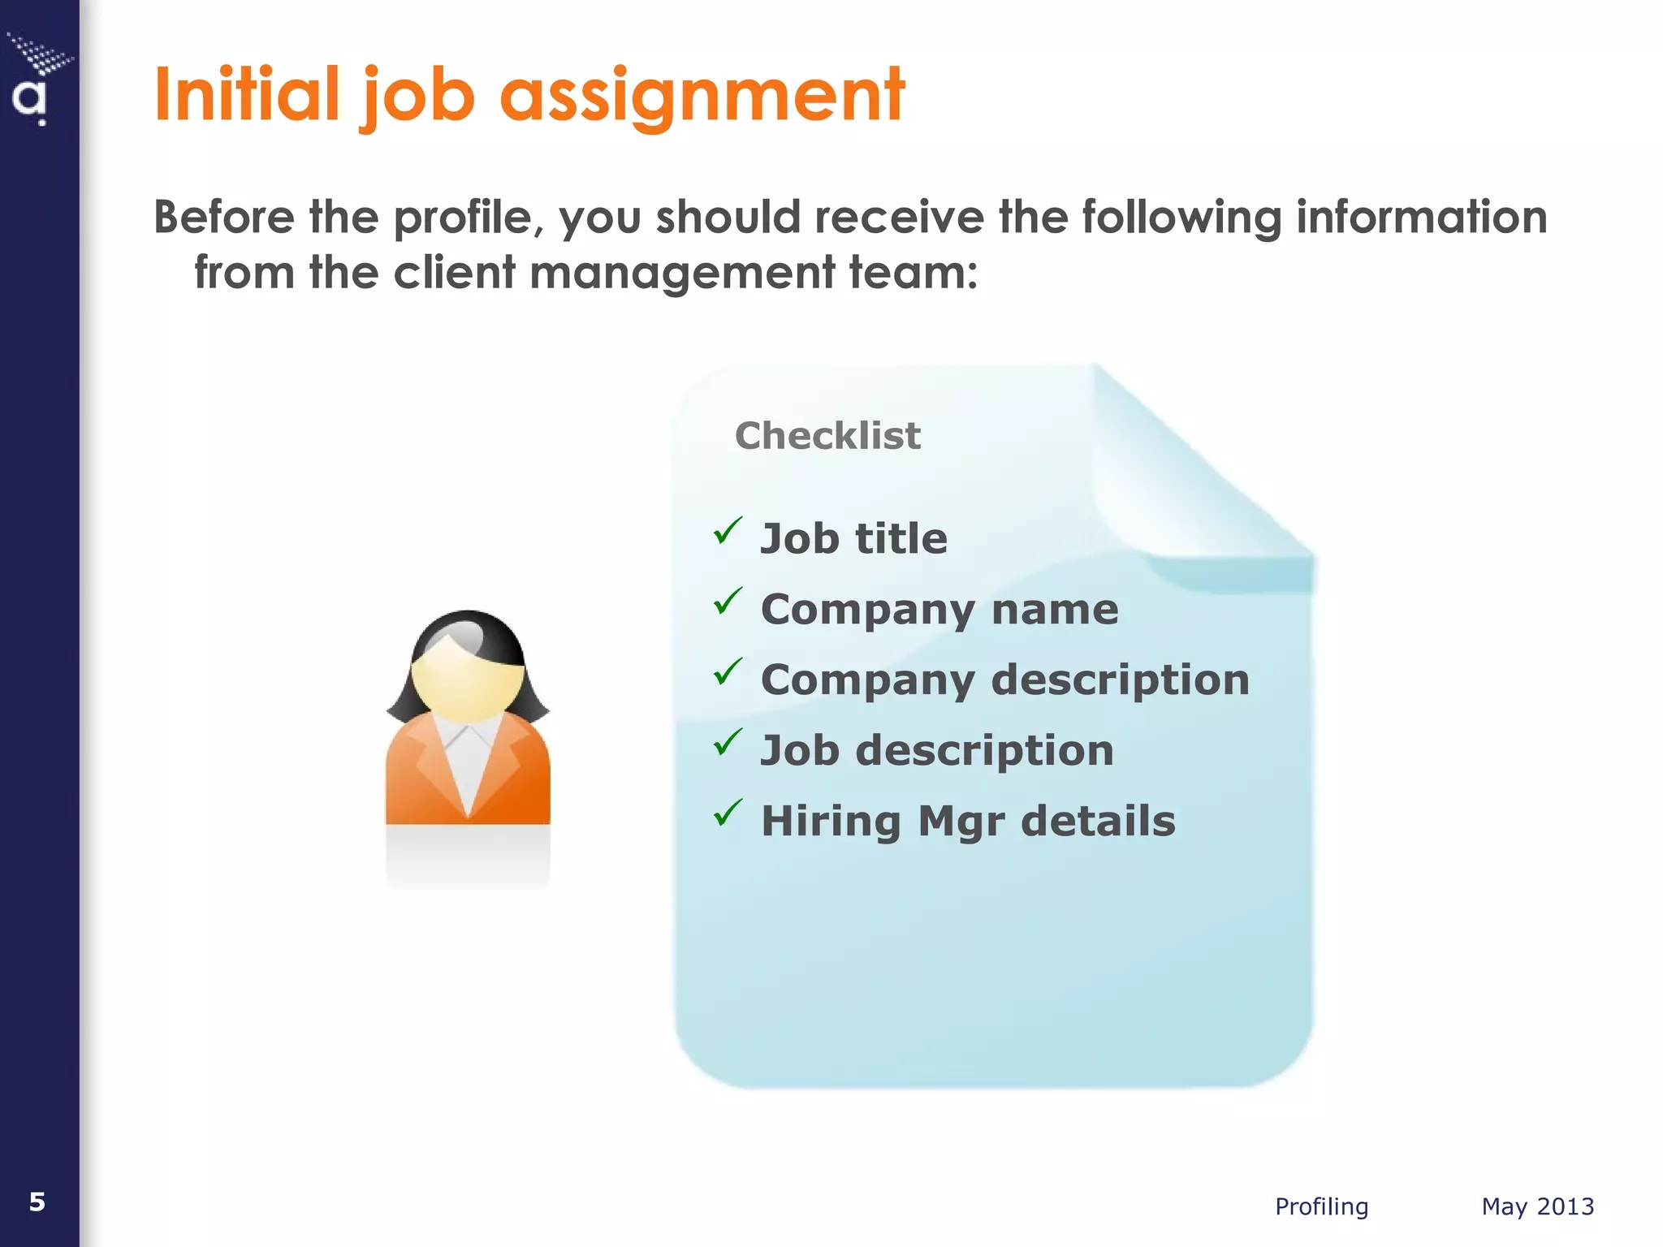
Job Profile Assignment

Slide 53
Role and Pu How To Write An Effective Job Profile? o of Communication
Here are some important steps that can help you understand how to write an effective job profile:
1. Write the job title and summary
Mention the exact name of the open position
Avoid using unique or creative titles that might confuse potential applicants
Include a short and clear description of the job position for which candidates are applying
The job title may also indicate a few other things about the option position, such as the seniority level and responsibilities of the position
In the job summary section, clearly mention if the job is going to be full-time, permanent or contract-based.

Slide 54
Role and Pu How To Write An Effective Job Profile? o of Communication
2. Provide company information
In this section, you can provide a brief description of the hiring company's background and area of activity
Portray the company in the best way possible and write about its vision, values and purpose.
Assume that the candidates are unaware of anything about the company and provide them with a detailed overview of the company's goals and mission.
3. Include responsibilities
Include the duties and responsibilities of the job role in this section of the job profile
Using relevant words can be helpful in seeking the attention of potential candidates
Explain what software and projects they may work on and what responsibilities they may take
Mentioning short and long-term objectives about the role can indicate how much effort the employees may put into the role.

Slide 55
Role and PuHow To Write An Effective Job Profile? o of Communication
4. Add requirements and qualifications
In the next section of the job description, include any specific requirements for the job, such as educational qualifications and work experience
Use a bulleted list while writing requirements and qualifications
You can also ask for professional certifications, educational credentials, the field of previous work experience and expertise in tools or software
Including a complete list of requirements can help candidates understand the job profile and apply for the job.

Slide 56
Role Importance Of Writing A Job Profile o of Communication
A job profile generally provides an overview of the duties and responsibilities a candidate has to perform on a daily basis after getting selected for the job
For candidates, every point in a job profile can be important. Elaborating on each section of the job profile can allow candidates to make an understanding of what to expect from the position
A well-written job profile can help a recruiter find the best potential employees for the job role
Job profiles provide a clear understanding and details about the responsibilities and primary duties of a particular role
It can help both the employees and the hiring company, as it demonstrates the basis of requirements for the selection of candidates
A well-defined job profile may also indicate the professionalism of a company

Slide 57
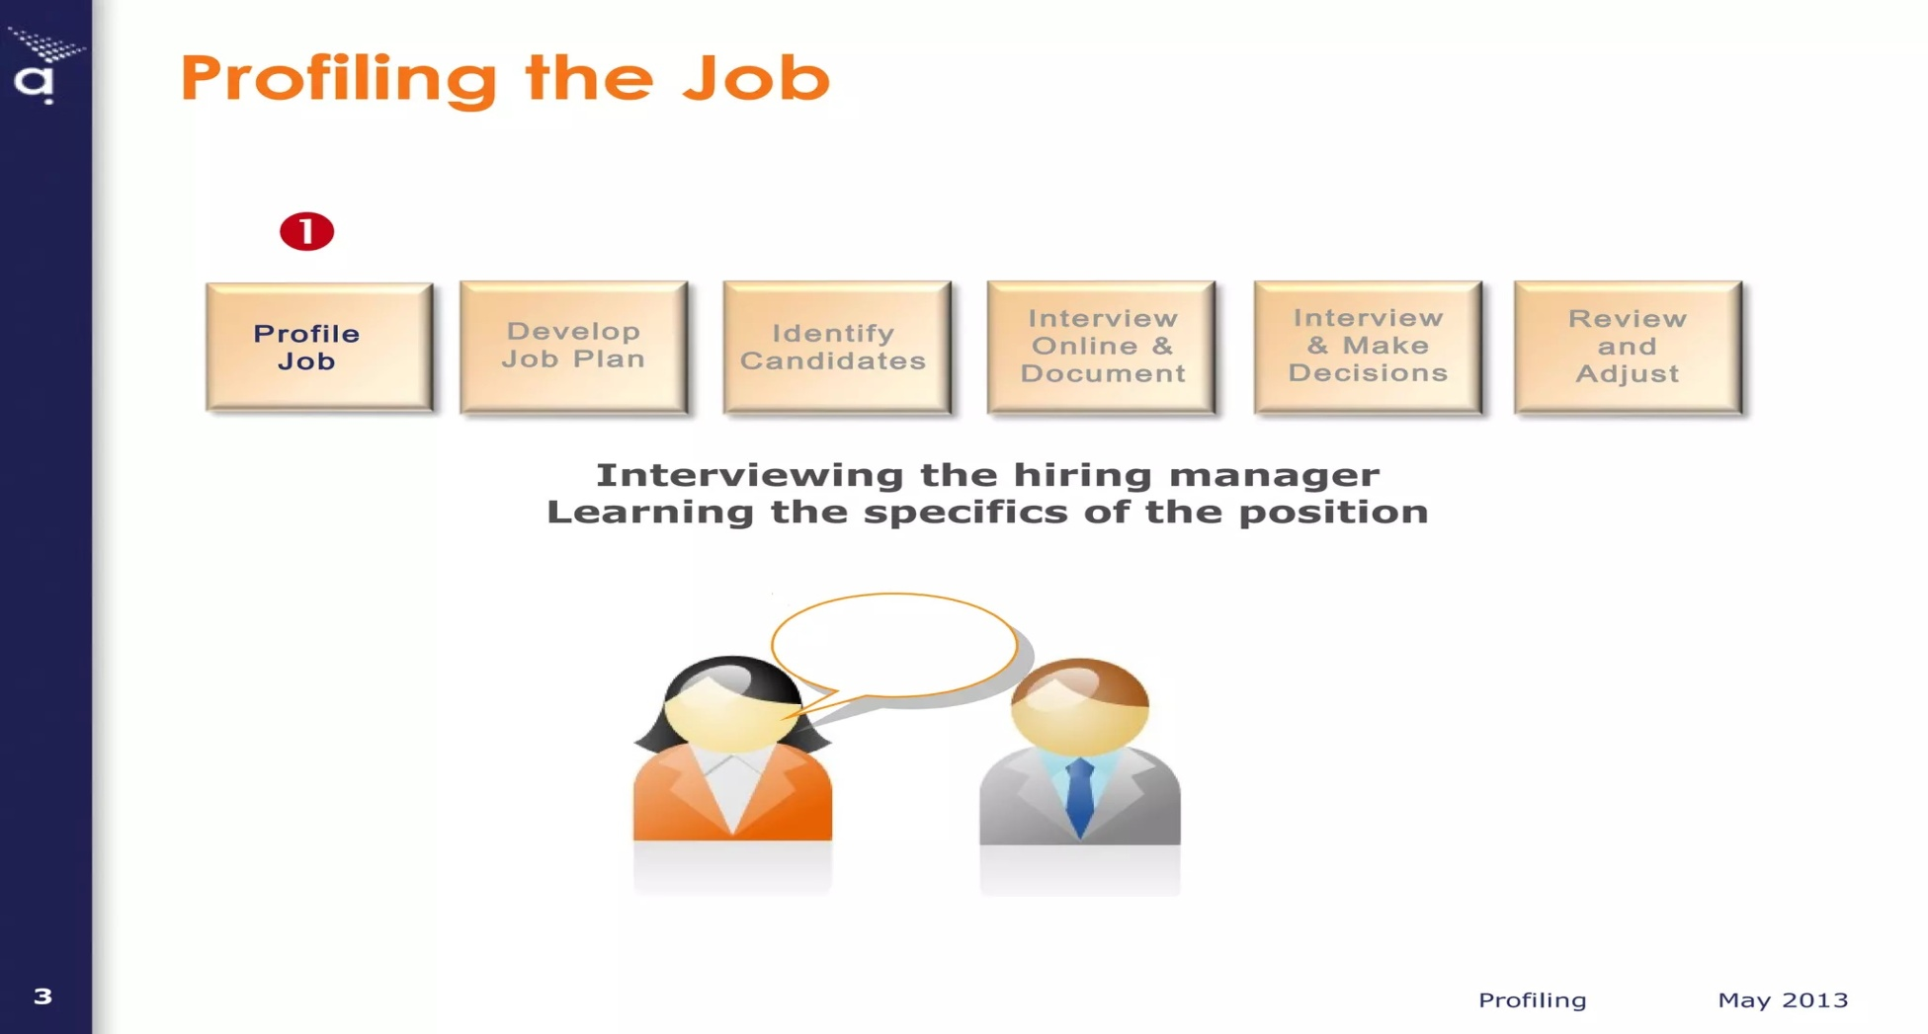
How to do job profiling

Slide 58
Role and PWhat Are The Elements Of A Job Profile? o of Communication
A job profile typically contains all the details that can help candidates thoroughly understand the role. From requirements to benefits, keeping everything clear in the job profile may result in successful hires. Here are some of the key elements that you can include in a job profile:
Job title: It is the job position for which candidates want to apply. The job title can help candidates identify if the position is an entry, mid or higher-level position.
Company details: You can add the history and vision of the company in this section. This can help candidates know more about the work environment and culture of the hiring organisation.

Slide 59
Role and Pu of CoWhat Are The Elements Of A Job Profile? mmunication
Job summary: It is the summary of the duties and responsibilities of the particular job role. It can help candidates understand the tasks they may perform in the role.
Job requirements: This section outlines the hiring company's minimum requirements in terms of educational qualifications, skills and characteristics, certifications and past work experience.
Job benefits: This section highlights the benefits such as health insurance and provident fund (PF) that candidates may receive from the company after getting the job.
Employment type: This section shows if the work is part-time, full-time or an internship role.

Slide 60
Role and Pu What Are The Elements Of A Job Profile? f Communication
Salary range: Adding salary range can be optional. You can add the salary range so that candidates can evaluate if the job is suitable for them.
Call to action: You can add an email address so that interested candidates can easily send their resumes. Adding a call to action can help candidates apply to the job role instantly.

Slide 61
RoleWhat is the average length of a job profile? f Communication
Many job profiles are an average of 300 to 600 words
An ideal job profile can be viewable in full on a computer screen
Many companies may fit the job profile on a single page so that applicants can gain the relevant information in one view

Slide 62

TOPIC 5
Communication & Networking
Building Relationships
Communication Networking and Building Relationships

Slide 63
Communication & Networking
Communication helps build relationships for several reasons. First, the more you listen, the more you learn about others' perspectives. Listening thoughtfully, without judgment or interruption, is also a show of caring and respect.
Networking at events can be incredibly powerful, working as a communication tool that builds and grows relationships in business. It offers a unique platform for face-to-face interactions, which can be more impactful than online connections.

Slide 64
What is networking and relationship building?
Professional networking is not just about meeting new people; it's also about maintaining existing relationships. This involves staying in touch with contacts, sharing updates on your work, and offering support and assistance when needed. This all supports your career growth and development.

Slide 65
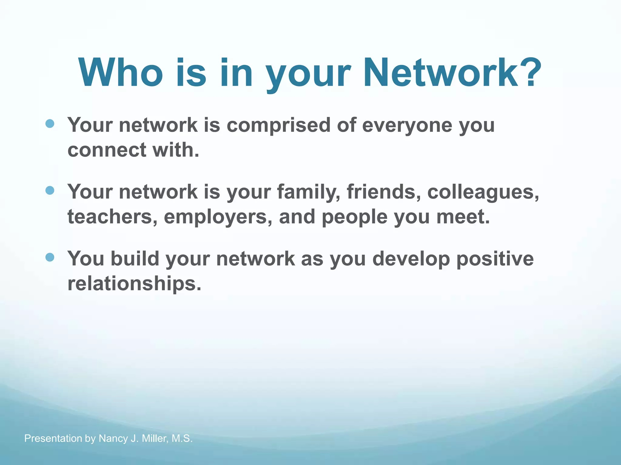

Slide 66
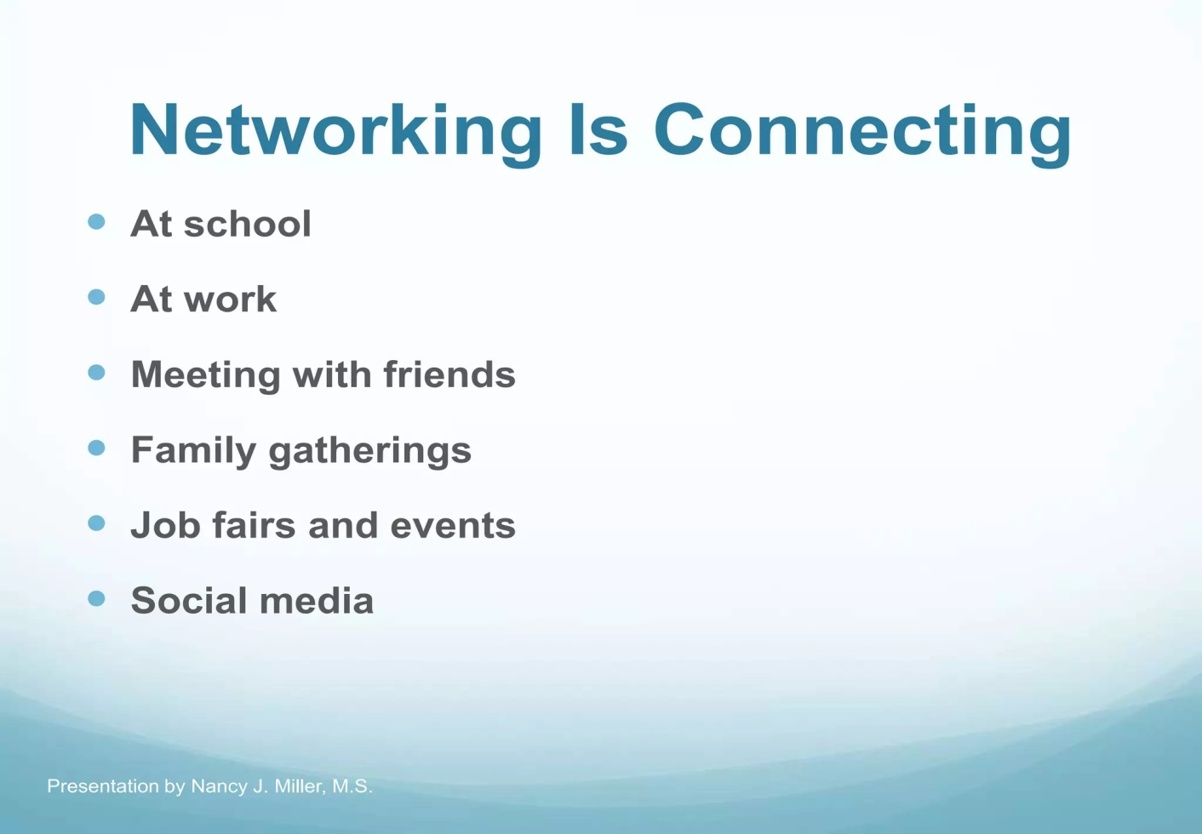


Slide 67
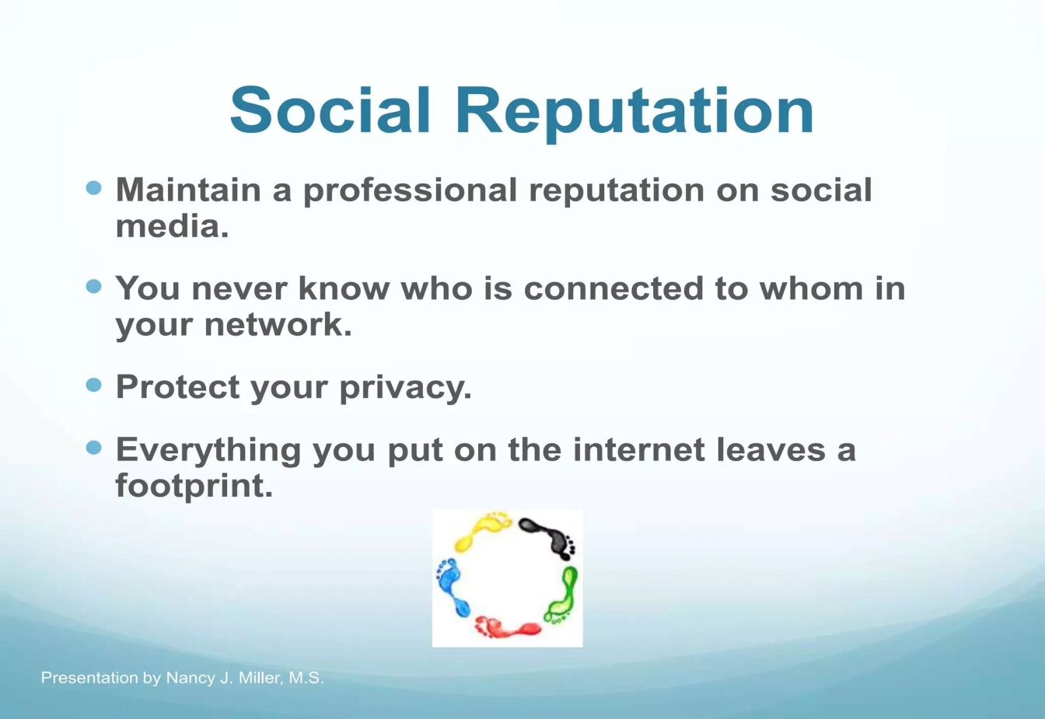


Slide 68

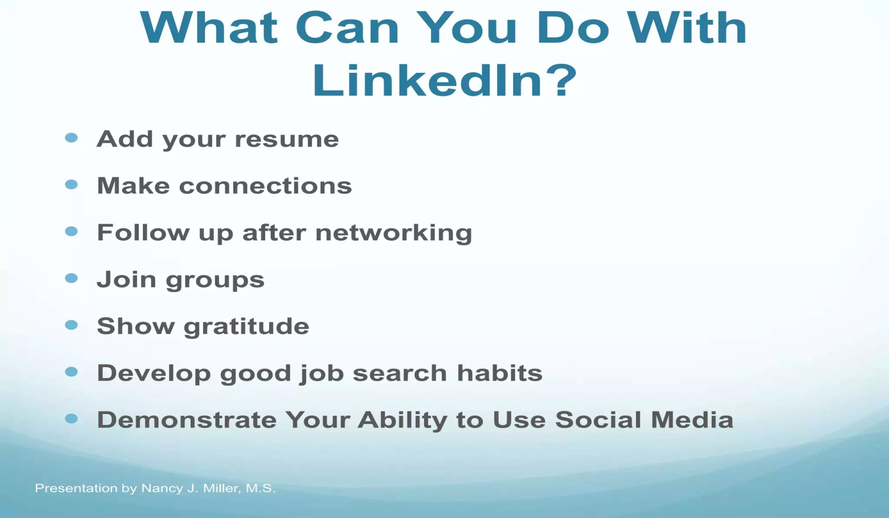
How to connect with LinkedIn?

Slide 69
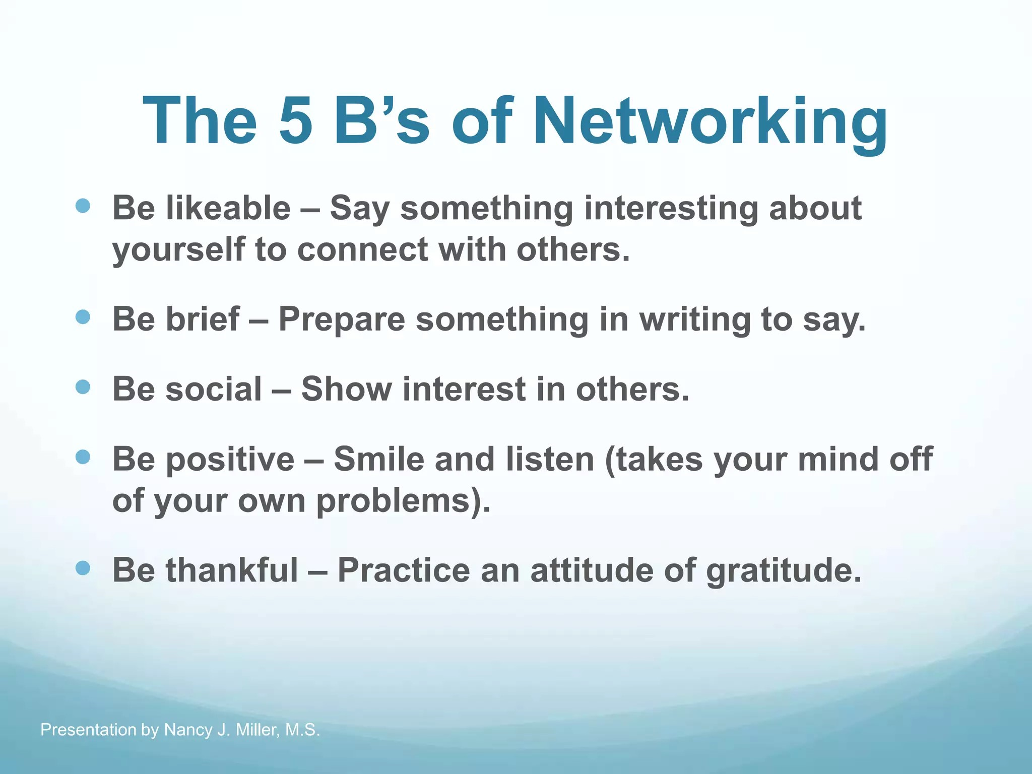

Slide 70

Building relationships through communication
Communication helps build relationships for several reasons. First, the more you listen, the more you learn about others’ perspectives. Listening thoughtfully, without judgment or interruption, is also a show of caring and respect. With stronger relationships come deeper feelings of trust. Once you have the basis of an honest, trusting relationship, anything is possible — even tackling the most difficult problems and obstacles.

Slide 71

Communication and Collaboration
Networking and building relationships are crucial components of success in any professional setting. It's not just about having the right product or service, but also about knowing the right people and building meaningful connections and networks.
So let's get started on this journey towards building stronger relationships and more successful collaborations.

Slide 72
Six Ways to Make Connections
Identifying And Building Meaningful Connections
Establishing Genuine And Meaningful Connections
Communication With Your Connection
Appropriate Etiquette
Collaboration And Teamwork
Maintaining Relationships

Slide 73
Identifying and Building Meaningful Connections
Identifying and building meaningful connections is crucial for success in any industry. You don't want to network with just anybody; instead, you should focus on identifying individuals who have similar interests, goals, or who can offer you support, guidance, and insight related to your professional pursuits.

Slide 74
Establishing Genuine And Meaningful Connections
The second point to keep in mind when networking and building relationships is the importance of establishing genuine and meaningful connections. In today's digital age, it's tempting to rely solely on social media and email to initiate contact with potential connections.

Slide 75
Communication With Your Connection
In business, effective communication is critical for building successful and long-lasting relationships. To achieve this, actively listening to the other person is crucial, which means giving them undivided attention without interrupting them. Nonverbal cues such as body language also play a role in effective communication, as they help in understanding what the other person is expressing.

Slide 76

Appropriate Etiquette
When building professional relationships, it's important to keep in mind the appropriate etiquette for the situation. You should do a little research on the person you're trying to build a relationship with to get a better understanding of their background and preferences. This includes understanding the appropriate dress code for the situation, as well as using proper language and displaying good manners.

Slide 77

Collaboration And Teamwork
Collaboration and teamwork are essential in building successful professional relationships, as many people are looking for individuals whose skills and services complement their own. This can lead to success in one's professional life, and it all begins with building a collaboration of some sort with that person. It is important to have proper communication, a clear understanding of each person's role and responsibilities, and to provide support and encouragement for one another.

Slide 78
Maintaining Relationships
Maintaining relationships is another essential in the professional world. Whether it's a short-term or long-term collaboration, it's important to establish periodic communication with your partner, client, or supplier. This can be in the form of checking in on their well-being, sharing news or information that could benefit them, or offering your skills or services for free.
When promising something, it's crucial to keep your word as it builds trust and credibility. Avoid making promises you cannot keep and be transparent and honest in your communication.

Slide 79
Conclusion
To summarize, building strong relationships through networking is an important process that requires identifying meaningful relationships and communicating effectively with the right people. When reaching out to someone, it's important to be clear about your goals and try to have one-on-one communication rather than relying on email or social media.
It's also important to understand the etiquette of the person you're meeting and tailor your approach to them. Maintaining these relationships requires meaningful and occasional gestures such as offering a skill or providing a referral.

Slide 80
TOPIC 6
STATEMENT OF PURPOSE

Slide 81
What is a Statement of Purpose or an SOP?
An SOP or a Statement of Purpose is a letter written by the applicant conveying their intent for choosing a particular course, their interests, goals and career plans. It is addressed to the admission committee. It is also known as a research statement or a letter of intent.
Through the SOP, you should be able to clearly articulate what made you choose a particular course and what you aim to gain through the course. Your passion for the subject should reflect in your SOP. The admission team should also get a glimpse of the positive aspects of your character through the SOP.

Slide 82
Why is an SOP important?
When applying for your studies abroad, all you are worried about is getting a good offer from a reputable institution, but you may not realise what goes on at the admissions office when they receive your applications. An SOP is crucial because:
It is perhaps the first document that attracts the admissions team to your profile. Hence, drafting a powerful SOP must be on your priority list.
Several candidates might have similar academic qualifications to yours. An SOP is your opportunity to make your application stand out from the rest.
It is also a reflection of how well you can articulate your thoughts, ambitions and plans.
Your SOP will give the admission committee a subjective view.

Slide 83
What makes a good SOP?
It should be original. There are plenty of sample SOPs available on the internet and it is not advisable to copy them verbatim.
Your Statement of Purpose should be free of grammatical errors
Your SOP should have answers to some crucial questions that the admission committee might have about you.
If the institution has requested the SOP in a particular format, make sure you follow it.
A good SOP will demonstrate your passion for the subject, your potential and your purpose for choosing the particular course.

Slide 84
What is the basic format of an SOP?
It is not an easy task to create an SOP or Statement of Purpose from scratch. Getting ready for an incisive SOP is going to take some time, probably weeks or months. But writing an SOP without following any guidelines will not help because most SOP rejections happen when those don’t comply with standard requirements.
Every SOP must have an introduction, body and conclusion. These three parts need to be clearly defined with the necessary information.
It should be written in the form of an essay, with paragraphs.

Slide 85
Format of an SOP
The first paragraph should introduce yourself, mention your academic qualification and give a gist of your purpose for choosing a particular course. You can talk about your goals and how this course can help fulfil your dreams. You should be able to demonstrate your understanding of what the course comprises.
In your second and third paragraphs, you can talk about your passion for the subject and mention your academic and related activities and achievements that prove this. If you have professional experience, you can mention that too.
In the fourth paragraph, write about why you decided to pursue this course, at this particular university. Justify your choice with relevant points. You can point out your immediate and long-term goals too.
In the fifth paragraph, add points to convince the admission committee that you make an ideal candidate for the course.

Slide 86
Format of an SOP Cont……..
In a short paragraph, mention your extra-curricular activities, projects you have undertaken, voluntary work, papers submitted if any, industry visits, workshops attended, dissertations and your interests and hobbies.
In your final paragraph, you should show the admission committee that you have the qualities and qualifications needed for succeeding in the course and that you will be able to make a difference in society with your success.

Slide 87
Tips for writing a good SOP or Statement of Purpose
Font style and size are vital while drafting an SOP. These are often missed or not followed by students while drafting an SOP.
Write your SOP in the active voice and let it have a positive feel altogether.
The SOP should have a formal tone, but keep it conversational.
It should have continuity.
Follow the instructions, if any, given by the institution. For example, you might be asked to limit your SOP to one page.
Use examples in your SOP to garner the attention of the reader. These will stand out more than generic statements.
Keep editing and rewriting, till the last date you send it across. The more you edit, the better your work becomes. If you are running out of words, let the draft sit in one corner for a few days, and then get back to it with a fresh mind.
Your SOP should be tweaked based on the institution or course that you are applying to.

Slide 88
Seminar and Conference
TOPIC 7
A conference is a formal meeting where people congregate to discuss a specific area of common interest while a seminar is an educational forum where members meet to acquire knowledge about a particular area.
Seminars take short period because they focus on a specific area while conferences may last for an extended duration since members discuss and share their opinion concerning the subject matter.
There is active participation in a conference where all the participants are required to give their feelings and opinions about a specific aspect while seminars offer limited involvement because participants receive directions from an expert.

Slide 89


Seminar and Conference………………contd.
A seminar takes an academic forum where participants acquire skills and knowledge and are given a certificate while conferences take a consultative view for discussion and members are not given a certificate.

Slide 90
Seminar
A seminar paper is a record of what you say to the group about a topic you have studied
It has the function of bringing together small group for frequent meeting, focusing each time on some particular subject
Preparing a seminar paper gives you practice in technical writing which will help you when you write your thesis

Slide 91
Seminar Paper
The type of seminar paper may be empirical, theoretical, critical or methodological in nature.
A critical review is the summarization and evaluation of the ideas and information in an article.
The review seeks to describe, summarize, evaluate, clarify and /or integrate the content of primary reports.
The seminar paper need not be a report of original and independent research.

Slide 92
General Format for Writing the Seminar Paper
Generally, there is no universally accepted standard of writing seminar
In most academic paper, a seminar must contain at least four basic elements:
Title
Text contains an introduction or background information section
The body of review containing the discussion of sources
Conclusion and /or recommendation section of the paper

Slide 93
Elements of Seminar Paper
Title
2. Author’s name
3 Approval Sheet
4. Abstract
5 Acknowledgement
6. Table of contents
a. List of tables
b. List of figures

Slide 94
Elements of Seminar Paper
7. Text/content
A. Introduction
B. Background
C. Objective
D. Review and discussion
E. Conclusion
8. Reference

Slide 95
Title
The title of seminar paper should state your topic exactly in the smallest possible number of words
First you must have a clear cut idea about the topic you choose
Contains as few words as possible (two lines)
Describes the contents of the paper accurately
Describes the subject as specifically as possible

Slide 96
Abstract
The abstract should state the most important facts and ideas in your paper
It should be complete in itself
It consists of a brief paragraph
Is short (200-300 words in one paragraph)
The purpose is to stimulate the expert in your subject area to read on
The abstract should state clearly the reports objectives of the research

Slide 97
Abstract does not contain
References to tables or figures
Abbreviations or acronyms
References to literature cited
Information or conclusions not in the paper

Slide 98
Text/content
Introduction
The introduction should:
Show why the reader should find the paper of interest.
It gives a quick idea of the topics of the literature review.
Give the background the reader needs to understand and judge the paper.
.

Slide 99
Text/content
Define the nature and extent of the problems studied
Explain the objectives and methods of investigation
Define any special terms or abbreviations
You do not exceed two type written pages

Slide 100
The objective /aim
It is the second part of the text.
It tells what the seminar aim for.
The theoretical background
You take the literature and tell the reader that you know what others have said about your subject before you.
A literature review is a body of text that aims to review the critical point of current knowledge
Literature reviews are secondary sources, and as such, do not report any new or original experimental work

Slide 101
How to Review
A well structured review is characterized by a logical flow of ideas;
current and relevant references with consistent appropriate referring style
proper use of terminology
unbiased and comprehensive view of the previous research on the topic
A review can be a simple summary of the sources, but it usually has an organizational pattern and combines both

Slide 102
How to Review
There are several ways to organize and structure a literature review
In issue based review (specific problem or concern) you will group and discuss your sources in terms of the themes or topics they cover
Generally you should get the information for your seminar paper from various sources, such as books, journals, lecture note, etc.
You must write not copy text write by other author.
Instead, select only the information you need and summarize this information in your own word

Slide 103
Conclusion
The conclusion should include:
A summary of major agreements and disagreements in the literature
A summary of general conclusions that are being drawn
A summary of where your seminar sits in the literature

Slide 104
Reference
A list of reference contains details only of those works cited in the text.
Referencing is a standardized method of acknowledging sources.
Direct quotations, paraphrases, facts and figures, ideas and theories both from published and unpublished sources must be referenced.
Sources for your written (text) and graphic material may include books, journal or magazine articles, newspapers, company, government or institutional reports, websites or personal communication.
There are many styles of referencing, but they can be divided into two main types.
The first is the footnote or endnote referencing style and the second is in-text referencing.

Slide 105
Footnotes & Endnotes
Footnotes are found at the bottom of a page (i.e. in the footer)
Endnotes are located at the end of a document, or sometimes at the end of a chapter or section

Slide 106
Research Ethics
Ethics refers to the correct rules of conduct necessary when carrying out research
Honesty
Honestly report data, results, methods and procedures, and publication status
Do not fabricate, falsify, or misrepresent data. Do not deceive colleagues, granting agencies, or the public
Objectivity
Strive to avoid bias in experimental design, data analysis, data interpretation, peer review, personnel decisions, grant writing, expert testimony, and other aspects of research where objectivity is expected or required.
Avoid or minimize bias
Disclose personal or financial interests that may affect research

Slide 107
Research Ethics
Integrity
Keep your promises and agreements;
Act with sincerity;
Strive for consistency of thought and action
Carefulness
Avoid careless errors and negligence; carefully and critically examine your own work and the work of your peers
Keep good records of research activities, such as data collection, research design, and correspondence with agencies or journals

Slide 108
Openness
Share data, results, ideas, tools, resources
Be open to criticism and new ideas
Respect for Intellectual Property
Honor patents, copyrights, and other forms of intellectual property
Do not use unpublished data, methods, or results without permission
Give credit where credit is due
Research Ethics

Slide 109
Research Ethics
Give proper acknowledgement or credit for all contributions to research
Never plagiarize.
Confidentiality
Protect confidential communications, such as papers or grants submitted for publication, personnel records and patient records

Slide 110

Expert Technical Lecture & Theme Clarity
TOPIC 8
Advantages, Types and Requirements or Tips

Slide 111
Introduction
The word “lecture” has been derived from the Latin word “lectura” meaning “reading”.
An oral presentation on a particular topic.
Meant to convey critical information, history, background, theories, etc.

Slide 112
Advantages & Disadvantages
Advantages-
Works as a stimulus.
Passes factual information quickly.
Useful for large as well as small gathering.
More economical.
Quick & straight forward way of communication.
Easily synthesizes and integrates a large body of knowledge.
Disadvantage - Mostly one-way method of delivery which relies on passive listening.

Slide 113
Types
Traditional –
Speaker is dominant.
Dependent on passive listening of audience.
Participatory -
Speaker begins with a brainstorming idea.
Dependent on Active participation and active listening skills of audience.

Slide 114
Delivering a Technical Lecture
Should be interesting, captivating and informative.
Maintain the focus
Use multimedia
Emphasize the objectives
Use basic presentation skills
Divide content into Introduction, Body & Conclusion

Slide 115
Pre-requisites
Theme Clarity
Presentation in a clear and logical sequences
Material should be meaningful and comprehensible
Adequate matter coverage
Proper presentation and analysis of data
Use of appropriate amount of technical terms
Proper presentation of findings

Slide 116
Achieve Theme Clarity through
Structural clarity
Stylistic clarity
Contextual clarity

Slide 117
Theme Clarity
Clarity which refers to ease of understanding is a special problem in technical and professional writing.
Technical subjects become difficult to grasp because of
Specialized languages
Mathematically detailed analyses
Complex conceptual schemes

Slide 118
Structural Clarity
Required to make it easy for the reader to get the large picture
Use abstracts and other forecasting strategies such as introductions that state the purpose and scope of the document.
Table of contents, problem statements and even strategic repetitions also promote structural clarity.
Graphs and tables, effectively designed and placed, help focus and clarify information.
Descriptive titles and frequent subject headings guide readers and help keep the large picture in focus.

Slide 119
Stylistic Clarity
Stylistic clarity is promoted by simple, direct language
Simplicity in language is attained with directly worded sentences
Using simple sentences, and avoiding overloaded sentences also contribute to clarity.
Word choice is a factor in stylistic clarity.
Avoid using highly specialized terms of science and technology.

Slide 120
Contextual Clarity
Contextual clarity emphasizes on importance, authorization, and implications of your work
Contributes to ease of understanding.
All work has a context, and your readers want to understand what the context of your document is
What prompts you to write?
What is your purpose?
Whose work precede has influenced yours?
What is the organizational and intellectual context of your document?

Slide 121
References
Web references:
https://online.hbs.edu/blog/post/leadership-communication
https://blog.hubspot.com/marketing/content-creation
https://vincenttriola.com/blogs/ten-years-of-academic-writing/sigmund-freud-carl-jung-carl-rogersabraham-maslow
https://www.verywellmind.com/jungs-theory-of-personality-learning-styles-2795160
https://www.humanmetrics.com/personality
https://hbr.org/2022/11/how-great-leaders-communicate

Slide 122
Thankyou

